Slide 1
What is a Service?
A service is any act of performance that one party can offer another that is essentially intangible and does not result in the ownership of anything; its production may or may not be tied to a physical product.

Slide 2
Difference between goods and services
Higher intangibility
Lack of ability to store them for future
Greater interaction between customer and service provider
Greater variability in service delivery
Greater variability among service customer’s expectations

Slide 3
Distinctive Characteristics/features of Services
Intangibility- Tangibilize ??
Inseparability
Variability
Perishability

Slide 4
Overcoming Service Challenges
Intangibility
Use cues to
make it tangible
Physical evidence
Inseparability
Increase
productivity of
providers
Services
Perishability
Match supply
and demand
Variability
Standardize
service
production
& delivery

Slide 5
Classification of services
End users
Individual Consumers
B2B
Degree of Tangibility
Highly tangible
Services linked to tangible goods
People Based service
High contact
Low contact
Industrial end Users
Highly intangible
Expertise Required
Highly professional service
Non Professional
Profit Orientation
Non Profit
Commercial

Slide 6
The Services Triangle
Service triangle is a strategic framework which visually reinforces the importance of people in the ability of firms to keep their promises and succeed in building customer relationships
Company
(Management)
Internal Marketing
External Marketing
“Enabling the promise”
“Making the promise”
Employees
Customers
Interactive Marketing
“Delivering the promise”

Slide 7
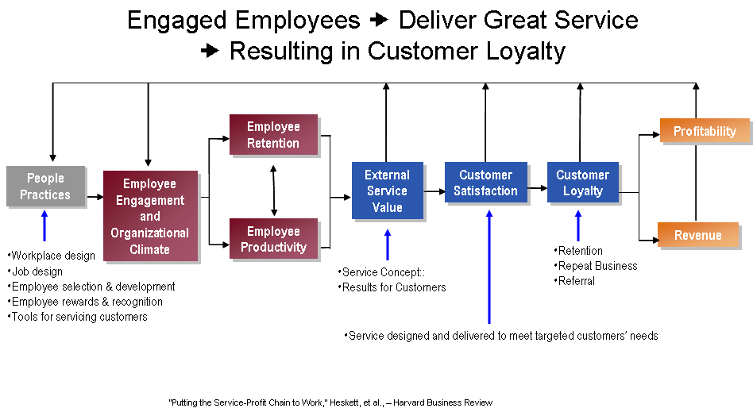
Service Profit Chain

